Slide 1



Solution to Homework 2
Estimated returns for
S&P500, June 2017
Cities with at least
one murder in 2012
Data from NLSY

Slide 2
Estimated returns for S&P500 for June 2017
% of returns between +1.0% and +5.0%
Did market do better or worse than predicted?

Slide 3
Data
4.3% of returns were –5.0 or less
→ –5 has Z = NORMSINV(0.043) = –1.7169 SD’s; i.e., –5 is 1.769 SD’s below average
→ Expressed mathematically, –5 =  – 1.7169 s
29.8% were between –1.0 and –5.0
→ 34.1% were less than –1.0
→ Expressed mathematically, –1.0 =  – 0.4097 s
→ Solve for two unkonwns: s = 3.06,  = 0.2538
Q1: P(1 < return < 5) = P(0.244 < Z < 1.551) = 34.3%
Q2: About as well as expected (0.25% predicted v. 0.32% actual)

Slide 4
Cities with one or more murder in 2012
3. Best way to summarize the histogram?
4. Correlation between “# of murders” and population?
5. # of states with a city with exactly one murder?
6. Riskiest city?

Slide 5
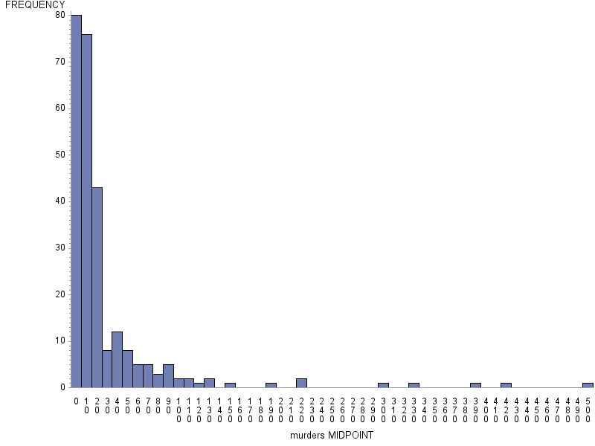
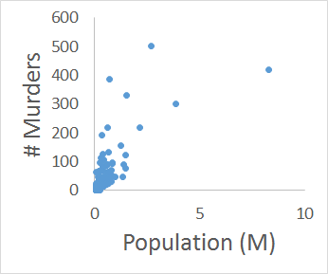
Q3: histogram is skewed to right (K₃ = 4.8)
Q4: correlation between population size and number of murders
= 0.7435
Larger cities tend to have a larger number of murders
0 100 200 300 400 500

Slide 6
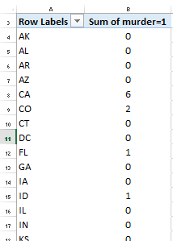
Q5: use pivot table
Create new column “murder=1?”
Create pivot table
Use “=COUNTIF( [..], “>=1”)
Answer: 12 states had at least one city with exactly one murder
Q6: to find riskiest state, look at murder rate, not absolute number of murders
Flint, MI has the highest rate (0.00062)
(By contrast, Chicago had rate 0.00018)

Slide 7
Data from the NLSY
7. Correlation between “avg GPA”, “avg income”?
8. Predicted avg income if average GPA = 3.179?
9. Error when predicting avg income for a major?
10. True or false: higher GPA → lower income

Slide 8
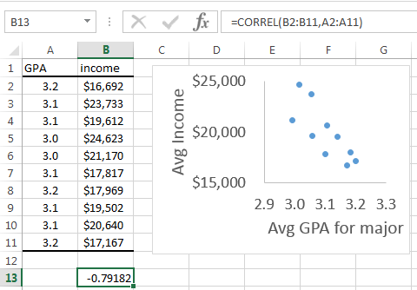
Q7: copy data into Excel … for different majors, correlation between GPA and income was r = –0.79
Q8: predicted major’s income if GPA = 3.179:
X = major’s GPA, Y = major’s average income
Slope = –29693, intercept = $111997.5, GPA = 3.179 → predicted average income = $17,603
Q9: SE_{Y|X} = $1743.97

Slide 9
Q10: It is true that majors that had lower average GPA’s also had higher average incomes, but the different majors may have different difficulties and different starting salaries. These data do not imply that increasing one’s GPA would cause a decrease in income, because GPA is confounded with choice of major and SAT score.

Slide 10
Any questions on Homework 2?
Estimated returns for
S&P500, June 2017
Cities with at least
one murder in 2012
Data from NLSY

